Slide 2
3.Preliminaries
3.1.High quality microblog stream
A microblog stream is a temporal sequence of microblog feeds M= {M₁ ,M₂ ,...,M_{l} ,...} where each feed M_{l} in the stream contains some attributes like Textual content,URLs,Fwd and review,Text length,Posting time
The stream is divided into slices, where each slice collects all the feeds published in the same time interval (e.g., one hour or one day).
In the case of twitter, nearly 36% of the rated tweets are worth reading, 25% are not, and 39% are middling;36% of feeds contain URLs.
A high quality microblog stream is the subset of the raw stream that is composed of meaningful microblog feeds and can represent the raw stream in a global manner.

Slide 3
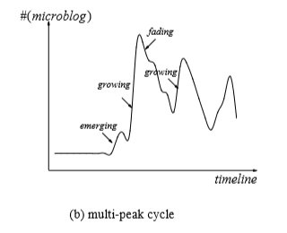
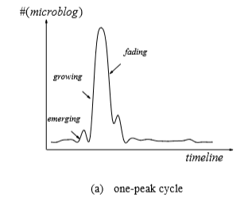
3.2. Topics evolution operations
In this study, a topic is considered significant if it is discussed with over η percent (η is set to 5% in our dataset) of feeds.
A topic in a time slice is called an emerging topic if it never appeared in previous slice and triggers a significant number of feeds in current slice. Thus, an emerging topic should be a novel topic that has a high level of novelty and low level of fading.

Slide 4
A topic in a time slice is called an emerging topic if it never appeared in previous slice and triggers a significant number of feeds in current slice. Thus, an emerging topic should be a novel topic that has a high level of novelty and low level of fading.
The given figure shows two types of topic life cycles, one-peak cycle and multi-peak cycle. In a topic life cycle, apart from emerging states, the other two evolutionary states are also worth noting, which we call growing and fading respectively.
A topic shows a growing trend if it has appeared before and attracts more feeds in current slice. Usually, a growing trend has a higher value of novelty than fading although it has appeared in previous slice.
A topic shows a fading trend if it has appeared before but attracts fewer feeds in current slice. Usually, a fading trend has a lower value of novelty than fading.

Slide 5
3.3. A brief Overview.
The three primary research challenges in this study are
(I) how to detect an emerging topic as early and accurately as possible;
(II) how to capture the topic evolution;
(III) how to generate coherent and meaningful topic.
(1)We propose a novel emerging topic tracking method, named ETT, to track what topics are emerging in microblog streams and how they evolve over time.
(1)Novelty is used to measure the freshness of a word/topic, whereas fading is used to measure the staleness of a word/topic.
(1)A method, based on local weighted linear regression (LWLR) is designed to predict the frequency for each of the words in current stream.

Slide 6
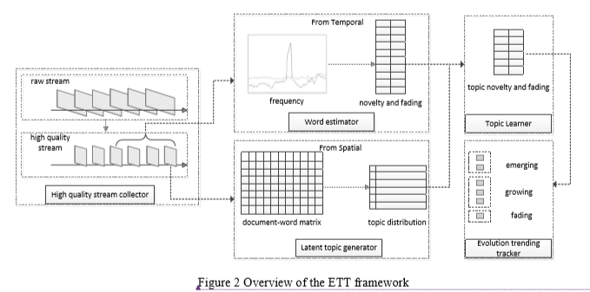
(2) Three topic evolution operations are defined to track emerging topics and their evolution over time,as discussed in the earlier segment
(3)A probabilistic topic model is employed to generate latent topics in the stream from spatial perspective. Finally, an optimization problem is formulated and solved to estimate the novelty and fading probabilities for all the latent topics.

